Slide 1
Robotic Club Project’s Proposal
Interactive LED screen
Version: 0.4
Date: Feb 21,2024
Author: Dao Nam THAI
Email: daothai@sheridancollege.ca
Notes:
https://www.riyas.org/2013/12/online-led-matrix-font-generator-with.html

Slide 2
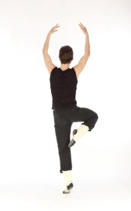


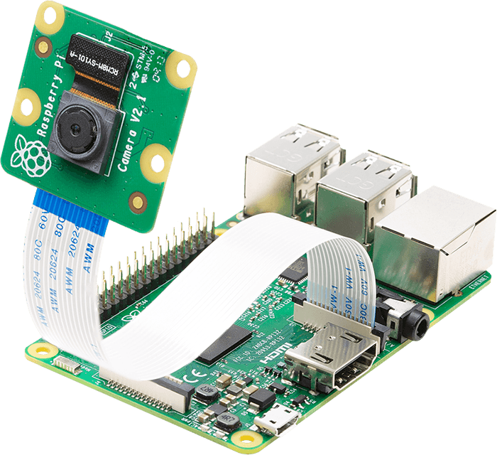
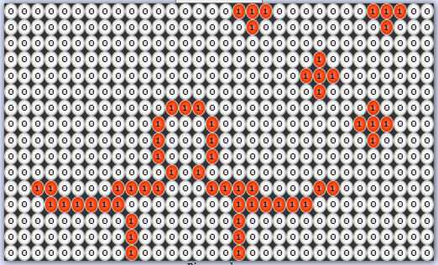
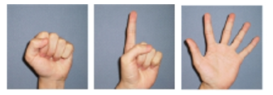
I. System Overview
(2)Raspberry Pi and Camera
(3) LED panel
(1a) Body gesture
Using open CV to get the human body/hand
Playing the interactive games in real-time
(1b) Hand gesture
Input
Processing
Output
Notes:
{B000000000000000000000000000000000000000000000000,
B000110010000000000000000000010000000000000000000,
B001001010000000000000000000010000000000000000000,
B001000011100011001010010011010011010101100000000,
B000110010010100101101010100110100110110010000000,
B000001010010111101000010100010100010100010000000,
B001001010010100001000010100110100110100010000000,
B000110010010011001000010011010011010100010000000}

Slide 3
II. User case (1) – active mode
Detect the human by ultrasonic sensors.
Take picture of human body.
Get contour of human body by using Raspberry Pi and OpenCV library
Display the contour on LED panel in real-time
When users stand in front of LED panel, it allows users play some interactive games such as Tetris, Snake, Rock paper scissors, Dunk Ball … etc

Slide 4
II. User case(2) – Idle mode
Display the current clock (EST, Indian, Chinese time …)
Display the current weather information.
Display the motivational quotes in multiple languages.
Etc…

Slide 5
III. Design plan
Hardware:
Rasperry Pi, Camera,
Arduino and LED matrix
Ultrasonic sensor
Power supply adapter and accessories
Software:
OS: Raspberry Pi
Programing language: Python, Script, C/C++
Library:
OpenCV ( Related to Hand Gesture Recognition, Human Gesture Recognition).
TensorFlow

Slide 6
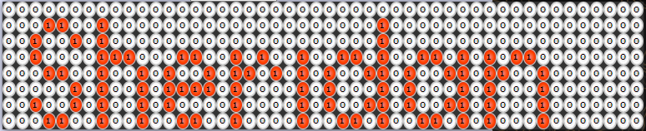

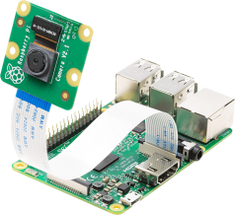
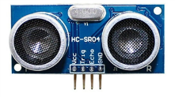


III. Development environment
Telnet, SSH, remote control
(2) Device
(B204)
(3) User
(1)Developers
(Robotics Club classroom)

Slide 7
III. Design plan - Flowchart diagram
Start
Idle
No
Active user?
Yes
Display
Clock, Weather conditions
Taking the picture
Activate game mode
Get contour
Timeout?
No
Display on LED matrix
Yes
Show the result
Wanna play game?
Yes

Slide 8
III. Design plan - BOM
No | Item | QTy | Price | Sum | Description | Remark
1 | Rasperry Pi 4 and accessories | 2 | $49.85 | 99.7 | https://www.digikey.ca/short/jnv5vq5c
2 | Camera 8M | 2 | $15.03 | 30.06 | https://www.digikey.ca/short/r7zpz4q5
3 | LED matrix panel | 2 | $98.61 | 197.22 | https://www.digikey.ca/short/nqbmz070 | Depend on size of screen
4 | Human detection sensor PIR motion detector | 2 | $8.19 | 16.38 | https://www.digikey.ca/short/q9wrp704
5 | Ultrasonic sensor | 4 | $6.83 | 27.32 | https://www.digikey.ca/short/zqb9wfd7 | Depend on size of screen
6 | Power supply | 2 | $18.00 | 36 | https://www.digikey.ca/short/f9dv2tr9 | Depend on size of screen
7 | Others | 1 | $200.00 | 200 |  | Enclosure, frame, wire
 |  |  |  | $606.68
Notes:
LED matrix control software
https://kno.wled.ge/
https://live-leds.de/

Slide 9
IV. References (TBD)
https://www.riyas.org/2013/12/online-led-matrix-font-generator-with.html
https://docs.opencv.org/4.x/d4/d73/tutorial_py_contours_begin.html
Pose Estimation on the Raspberry Pi 4
https://github.com/ecd1012/rpi_pose_estimation
https://www.digikey.ca/en/maker/tutorials/2022/introduction-to-image-processing-raspberry-pi
https://www.cl.cam.ac.uk/projects/raspberrypi/tutorials/image-processing/
Alternative solution by ESP32
https://www.digikey.ca/short/9b3ft5n2
Adafruit RGB Matrix Bonnet for Raspberry Pi
https://www.adafruit.com/product/3211

